Slide 1
PETGEN: Personalized Text Generation Attack on Deep Sequence Embedding-based Classification Models
Bing He, Mustaque Ahamad, Srijan Kumar
Georgia Institute of Technology
Email: bhe46@gatech.edu, srijan@gatech.edu
All code and data at: https://github.com/srijankr/petgen

Slide 2
Malicious Users on Social Media
A critical task for social media platforms to ensure safety and integrity
~5% monthly active users are fake accounts in Facebook
~63% reviews on Amazon beauty are fake
Other types of malicious users: fraudsters, trolls, spammers, cyber-bullies

Slide 3
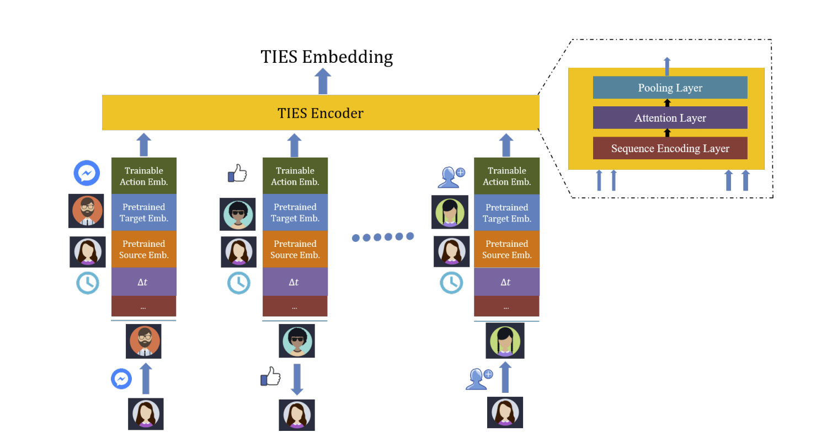
Deep Learning Solutions
Deep learning methods have been created to detect malicious users
Many solutions use user activity sequences for detection
TIES (Facebook)
JODIE
HRNN
Figure reference:
TIES paper

Slide 4
Adversaries are Active
Malicious users can change their behavior to avoid detection
Prior deep learning models, from computer vision and NLP domains, have been shown to be vulnerable
Vulnerability of deep user sequence embedding models is unknown

Slide 5
Key Question
Can malicious users avoid detection by exploiting model vulnerabilities?

Slide 6
Key Question
Can malicious users avoid detection by exploiting model vulnerabilities?
Our Solution: Adversarial evasion attack on
deep user sequence classification models

Slide 7
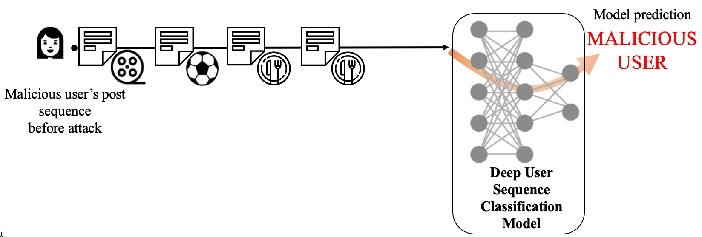
Our Attack: Next Post Attack

Slide 8
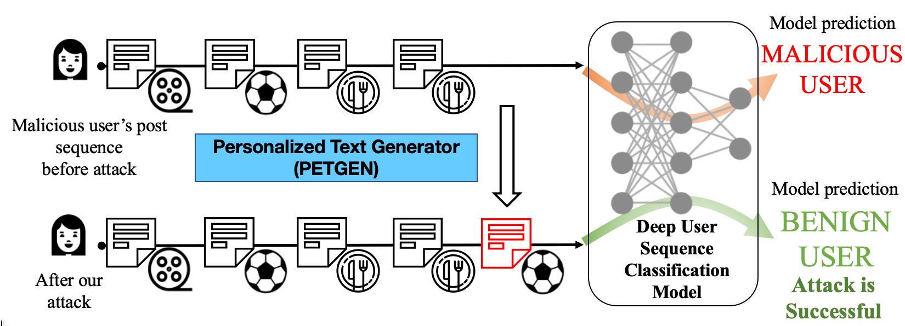
Our Attack: Next Post Attack
Adversary generates a new post, such that the user classification changes.

Slide 9
Desirable Properties of Attack Post
What are the desirable properties of the attack post?
Should fool the classification model
Should be knowledgeable about the target context
Should be realistic and personalized
Aware of user’s writing style
Recent vs past interests
Aware of user’s past posts on similar topics

Slide 10
Existing Methods
C1
Attack
goal
C2
Target context
C3
Personalized
Modification-based attack
Copycat
Hotflip
Universal Adversarial Trigger
TextBugger
Generation-based attack
Malcom
Our model: PETGEN

Slide 11
PETGEN
Personalized Text Generator
End-to-end multi-stage multi-task text generation framework
Two major modules:
PETGEN
User sequence
+
Target Context
Sequence-aware Text
Generator
Multi-task
Tuning
Intermediate post
Generated Attack Post

Slide 12
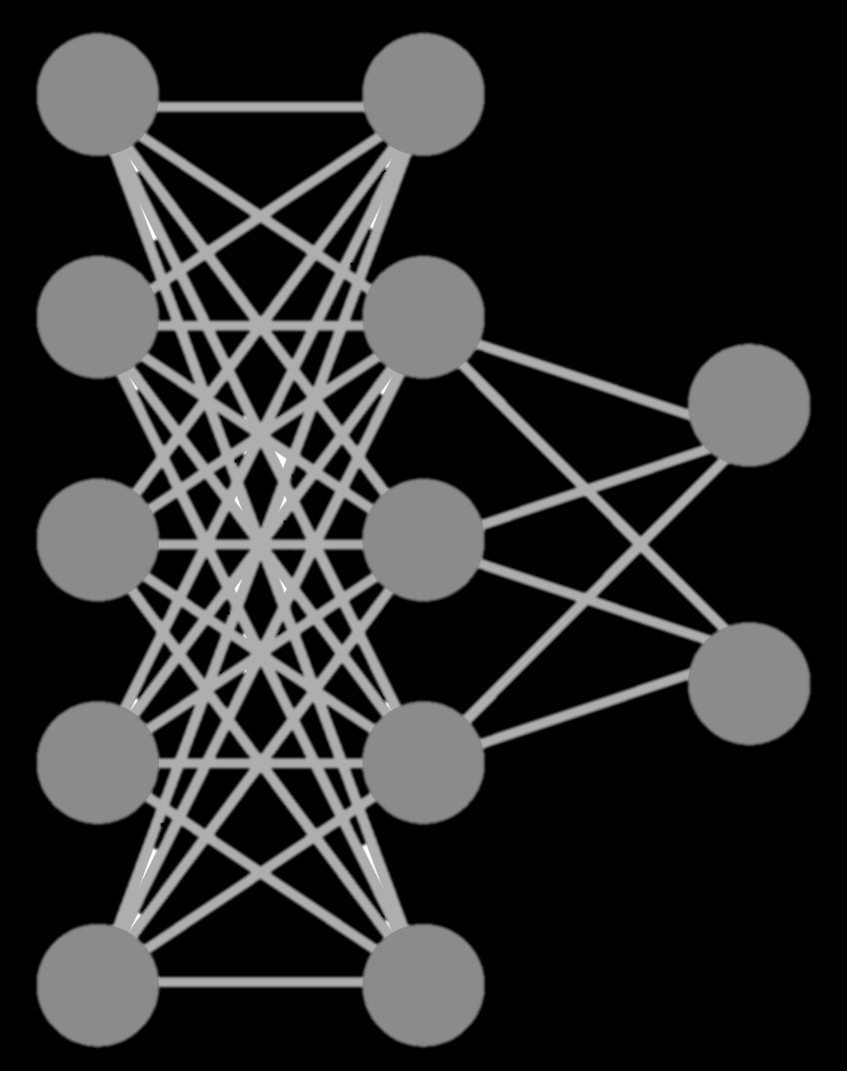
Personalized Text Generator: PETGEN
Attack
Style
Recent Post Relevance
Deep User
Sequence Embedding
Model
PETGEN
Posts
Sequence-aware Text
Generator
Multi-task Tuning
Contexts
Generated Attack Text
Target
context
relevance
Contextual post relevance
Target Context

Slide 13
Personalized Text Generator: PETGEN
Attack
Style
Recent Post Relevance
Deep User
Sequence Embedding
Model
PETGEN
Posts
Sequence-aware Text
Generator
Multi-task Tuning
Contexts
Generated Attack Text
Target
context
relevance
Contextual post relevance
Target Context

Slide 14
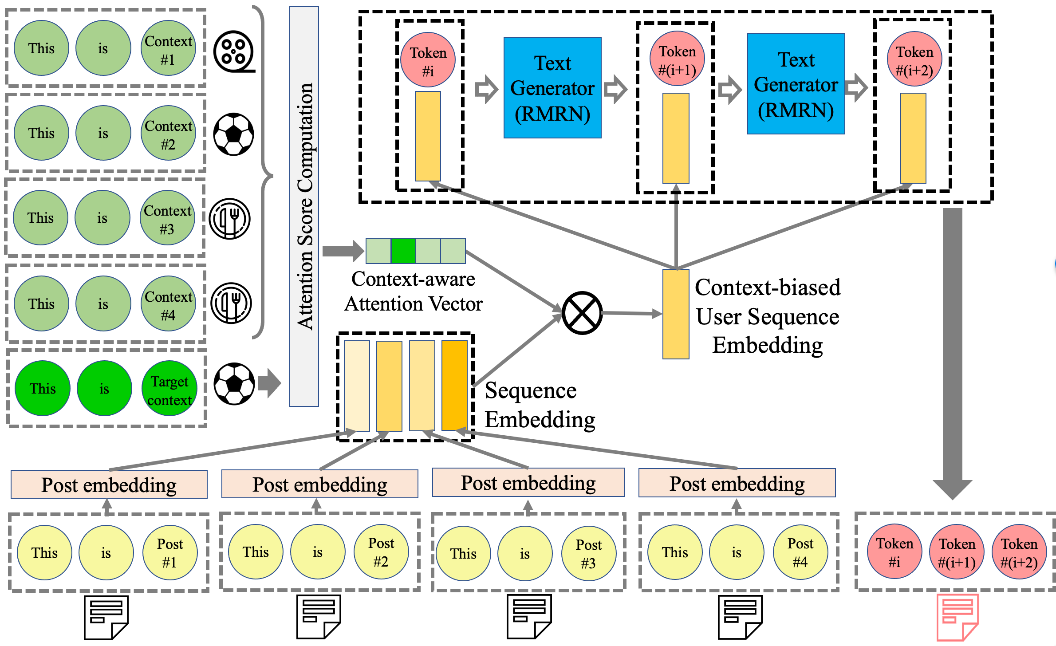
Sequence-Aware Text Generator
Capture contextual relevance from
previous
posts

Slide 15
Sequence-Aware Text Generator
Capture contextual relevance from
previous
posts
Capture user sequence embedding

Slide 16
Sequence-Aware Text Generator
Capture contextual relevance from
previous
posts
Capture user sequence embedding

Slide 17
Sequence-Aware Text Generator
Text generator module
Capture contextual relevance from
previous
posts
Capture user sequence embedding

Slide 18
Sequence-Aware Text Generator
Text generator module
Capture contextual relevance from
previous
posts
Capture user sequence embedding
Attack
post

Slide 19
Personalized Text Generator: PETGEN
Attack
Style
Recent Post Relevance
Deep User
Sequence Embedding
Model
PETGEN
Posts
Sequence-aware Text
Generator
Multi-task Tuning
Initial post
Generated Attack Text
Contexts
Target
context
relevance
Contextual post relevance
Target Context

Slide 20
Multi-Task Tuning
Four objectives:
Style: Relativistic GAN loss
Attack: Cross-entropy loss
Recent Post Relevance: Maximum Mean Discrepancy (MMD) Loss
Target Context Relevance: MMD Loss
Optimization strategy:
Multi-stage loss optimization. One loss is optimized at a time
Done till convergence.

Slide 21
Personalized Text Generator: PETGEN
Attack
Style
Recent Post Relevance
Deep User
Sequence Embedding
Model
PETGEN
Posts
Sequence-aware Text
Generator
Multi-task Tuning
Initial post
Generated Attack Text
Contexts
Target
context
relevance
Contextual post relevance
Target Context

Slide 22
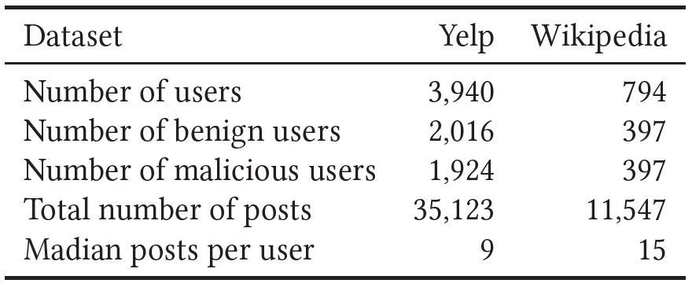
Evaluation Setup
Deep user sequence classification model
TIES model [1]
Hierarchical Recurrent Neural Network (HRNN) [2]
Datasets
Code and data are available at: https://github.com/srijankr/petgen
Noorshams, Nima, Saurabh Verma, and Aude Hofleitner. "TIES: Temporal Interaction Embeddings For Enhancing Social Media Integrity At Facebook.", SIGKDD,. 2020.
Zhao, Yi, Yanyan Shen, and Junjie Yao. "Recurrent Neural Network for Text Classification with Hierarchical Multiscale Dense Connections." IJCAI. 2019.

Slide 23
Baseline Attacks
Copycat: copy user’s past post on similar context
HotFlip: Copycat + replace most important word with similar word
UniTrigger: Copycat + add tokens to the end of the post
TextBugger: Copycat + deletion/swap of characters
Malcom: state-of-the-art model
No baseline is sequence-aware

Slide 24
White-Box Attack Performance
Attack on the TIES model on Yelp data
Model performance reduces against all attacks.
PETGEN is the most successful attack.
No attack
F1 score

Slide 25
White-Box Attack Performance
Model performance reduces against all attacks
PETGEN is the best attack

Slide 26
Black-Box Attack Performance
No attack
Lower is better
F1 score
HRNN surrogate model is trained on the observed outputs of the TIES black-box model.
Black-box attacks are also successful. Attack performance lower than white-box.
PETGEN is the most successful attack.

Slide 27
Black-Box Attack Performance
A HRNN surrogate model is trained on observed outputs of the original black-box model.
Black-box attacks are also successful. Attack performance lower than white-box.
PETGEN is the most successful attack.

Slide 28
Generated Text Quality
How realistic is the generated text?
BLEU score
Target Context Similarity
Recent Post Similarity
Contextual Post Similarity
PETGEN has the best text generation quality

Slide 29
Human Evaluation of Text Quality
Two human raters were shown a pair of texts generated by Malcom and PETGEN
Text generated for the same setting
50 pairs
Task: which text is more realistic?
Inter-rater agreement = 0.66
PETGEN texts are more realistic 60% of the times.

Slide 30
Ablation Study
All components of PETGEN contribute to the performance
PETGEN with all components is the best or second best in most cases
Notation: Bleu score (BLEU), Target Context Similarity (TCS), Recent Post Similarity (RS), Contextual Post Similarity (CPS)

Slide 31
Conclusions
PETGEN is the first attack framework against user sequence classification models
Models are vulnerable against attacks
PETGEN is the most effective attack and generates reasonable text
Generated attacks can be used to create more robust models
All code and data at: http://claws.cc.gatech.edu/petgen

Slide 32
Postdoc Opening
Join us at Georgia Tech!
One postdoc position to work in recommendation systems and/or graphs
Contact me: srijan@gatech.edu or say hello during KDD

