Slide 1
Focused Inference in Markov Random Fields & the M-Best Mode problem
Dhruv Batra
Research Assistant Professor TTI-Chicago

Slide 2
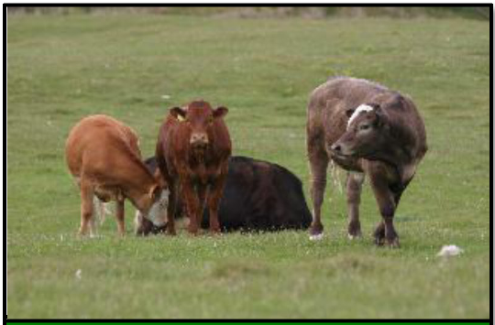
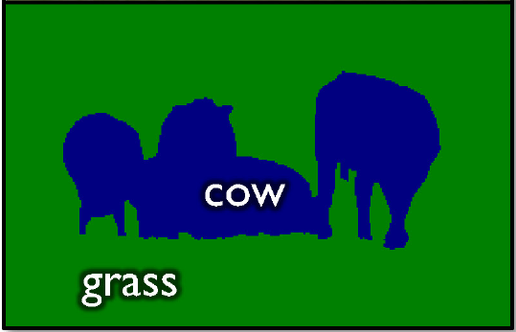
Structured Output Prediction
Machine Learning [Pre-90s]
Machine Learning Today
x
x
x
x
x
x
x
x
x
o
x
o
o
o
o
o
o
o
o
2 Classes
Exponentially Many Classes
+1, -1
all trees, all labellings

Slide 3
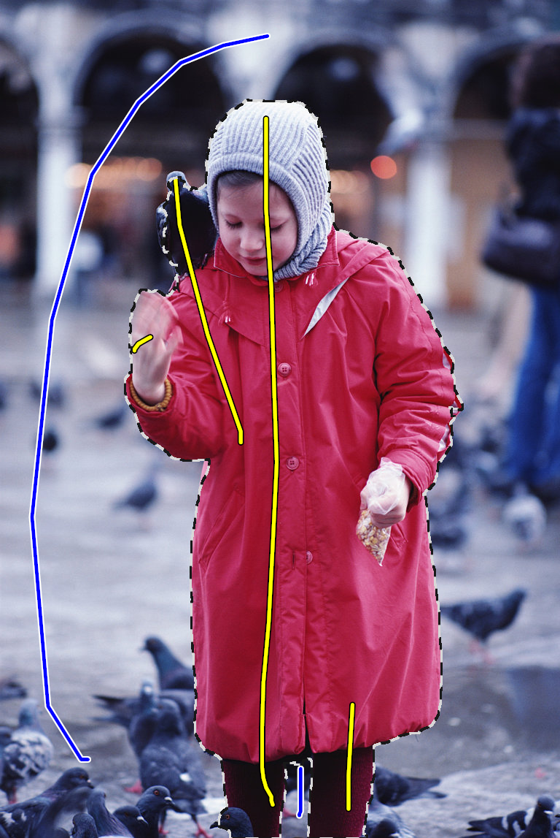
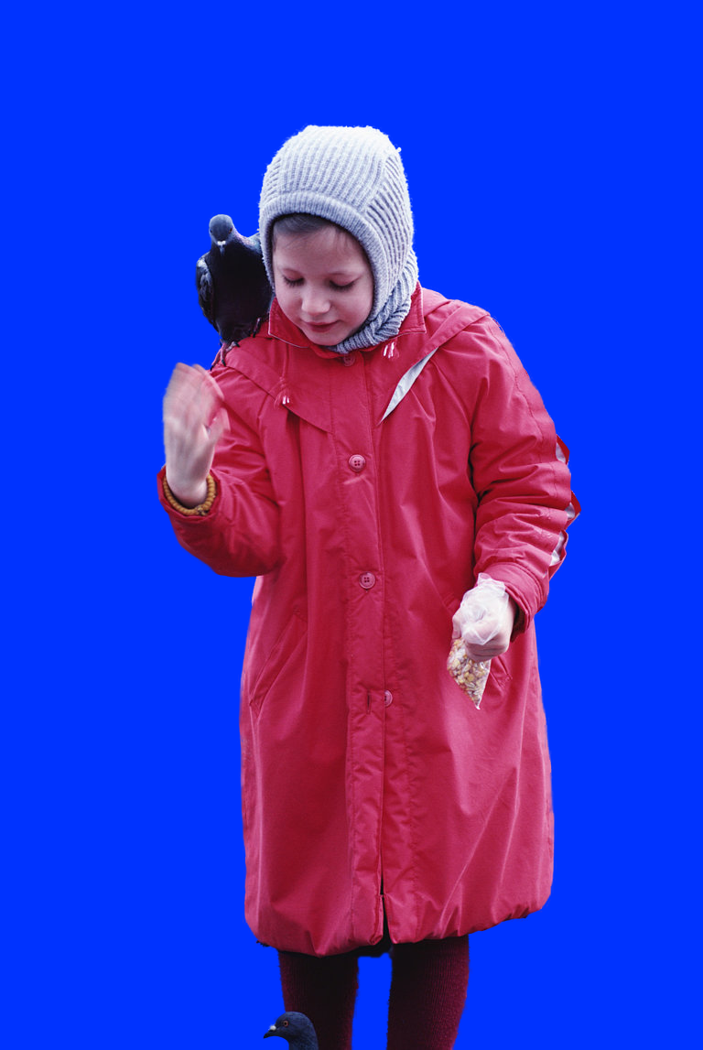
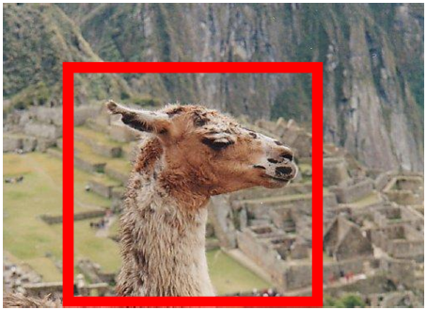
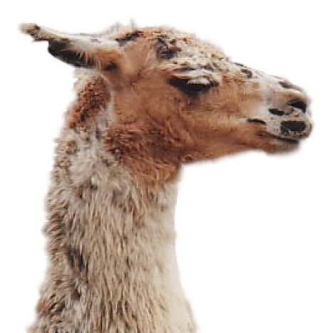
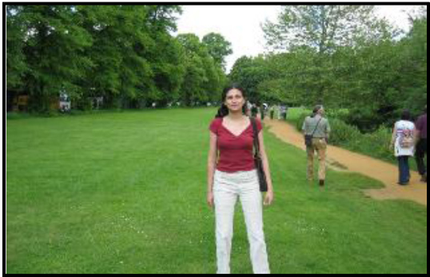
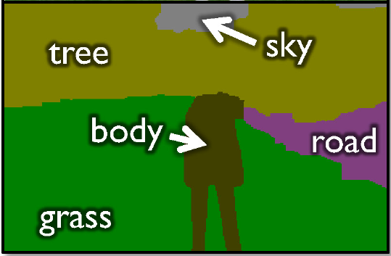
Structured Output
Segmentation
[Ren et al. ECCV ’06], [Boykov and Jolly, ICCV ’01], [Rother et al., SIGGRAPH ’04]
[He et al. ECCV ’06], [Yang et al. CVPR ’07], [Shotton et al. IJCV ’09], [Batra et al. CVPR ’08].

Slide 4
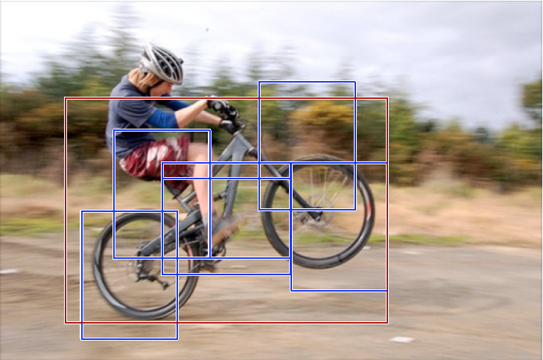
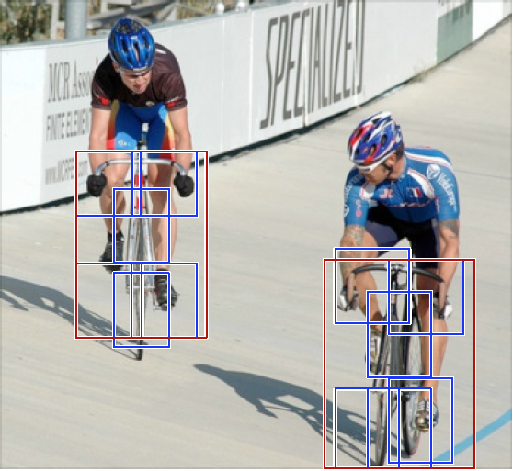
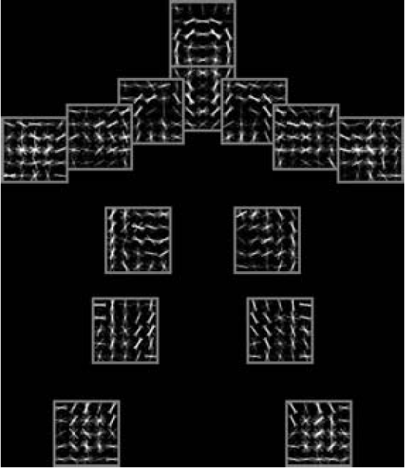
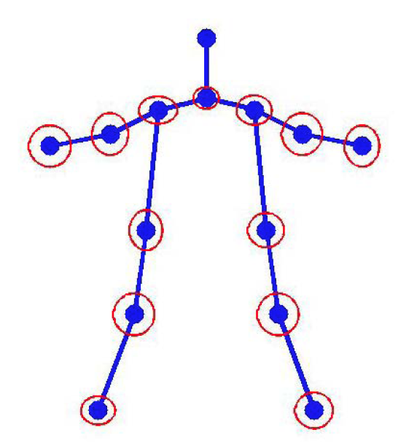
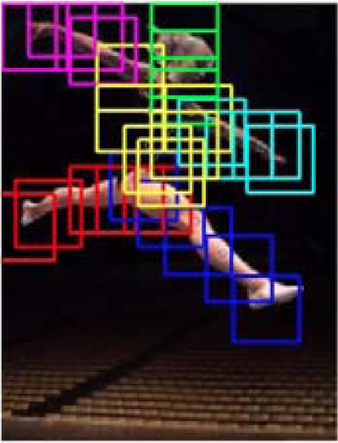
Structured Output
Parts based models
[Felzenszwalb et al. PAMI ‘10], [Yang and Ramanan, ICCV ‘11]

Slide 5
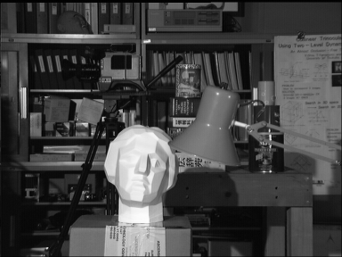
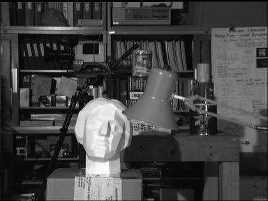
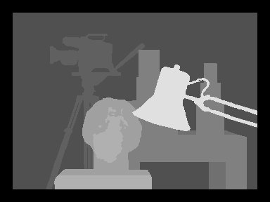
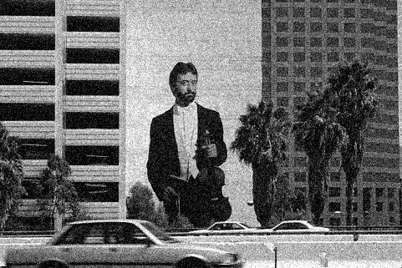
Structured Output
Stereo (Disparity Labelling)
[Roy and Cox, ICCV ‘98], [Boykov et al. CVPR ’97, PAMI ‘01], [Scharstein et al. PAMI ’02].
Motion Flow
[Boykov et al. PAMI ’01]
Denoising
[Sebastiani et al. Signal Proc. ’97], [Roth et al. IJCV ‘09], [Li et al. ECCV ’08], [Ishikawa CVPR ’09].
Left image
Right image
Disparity map

Slide 6
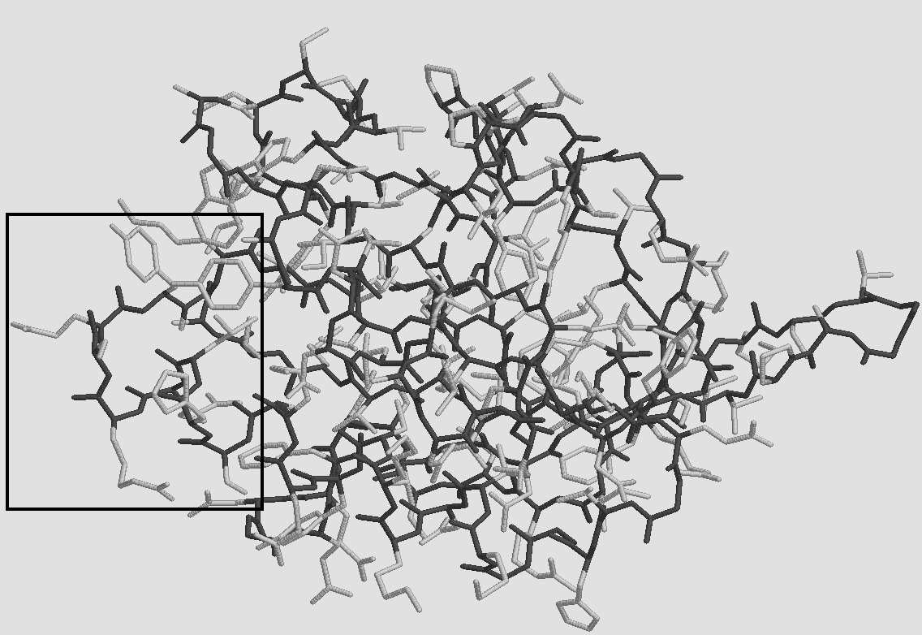
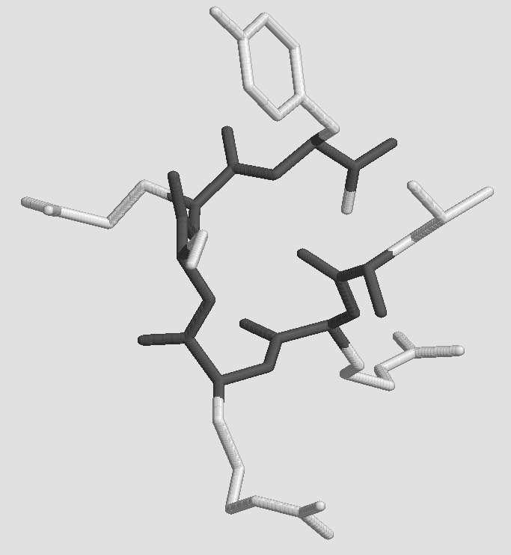
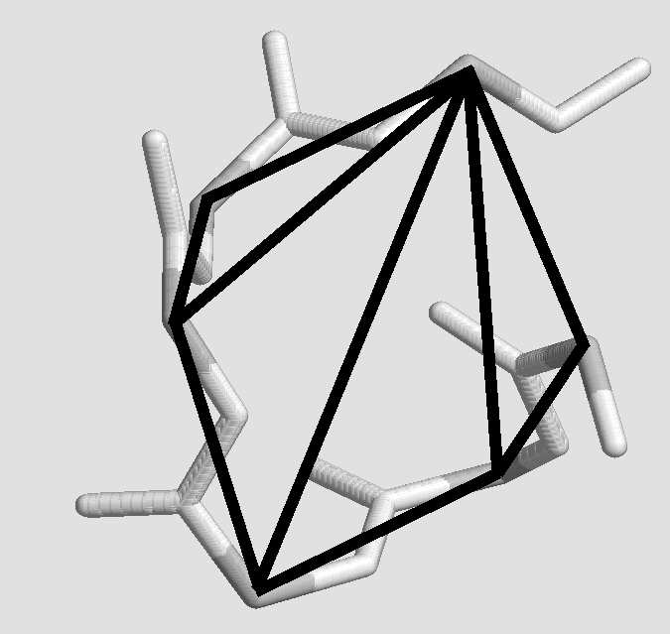
Structured Output
Protein Side-Chain Prediction
Figure courtesy Yanover & Weiss NIPS02

Slide 7
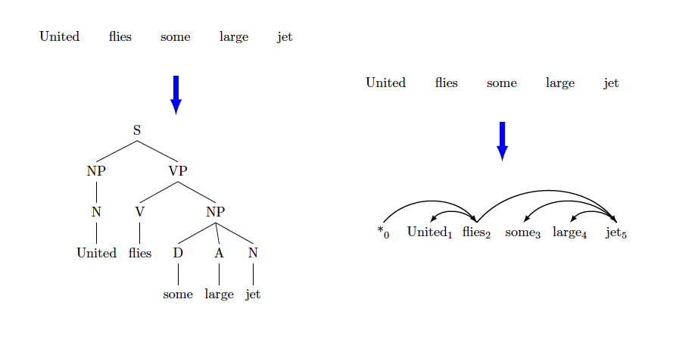
Structured Output
Dependency parsing
Figure courtesy Rush & Collins NIPS11

Slide 8
Structured Output Prediction
Machine Learning [<1990]
Machine Learning Today
x
x
x
x
x
x
x
x
x
o
x
o
o
o
o
o
o
o
o
2 Classes
Exponentially Many Classes
+1, -1
all trees, all labellings

Slide 9
Structured Output Prediction
Machine Learning Today
Modeling
Inference
Learning
Exponentially Many Classes
all trees, all labellings

Slide 10
Structured Output Prediction
Focused Inference -- [Batra, Nowozin, Kohli AISTATS ’11] -- [Batra, Kohli CVPR ’11] -- [Tarlow, Batra, Kohli, Kolmogorov ICML ‘11]
Modeling
Inference
M-Best Modes -- [Yadollahpour, Batra, Shakhnarovich, DISCML-NIPS ’11]
Learning

Slide 11
Markov Random Fields
X₁
Set of discrete random variables
Factored-Exponentials
X₂
…
X_{n}
Node Energies / Local Costs
Edge Energies / Distributed Prior
kx1
kxk

Slide 12
Structured Output Prediction
Focused Inference -- [Batra, Nowozin, Kohli AISTATS ’11] -- [Batra, Kohli CVPR ’11] -- [Tarlow, Batra, Kohli, Kolmogorov ICML ‘11]
Modeling
Inference
M-Best Modes -- [Yadollahpour, Batra, Shakhnarovich, DISCML-NIPS ’11]
Learning

Slide 13
MAP Inference
MAP problem
In general NP-hard [Shimony ‘94]
Approximate Inference
Heuristics: Loopy BP [Pearl, ‘88]
Greedy: α-Expansion [Boykov ’01, Komodakis ‘05]
LP Relaxations: [Schlesinger ‘76, Wainwright ’05, Sontag ’08, Batra ‘10]
QP/SDP Relaxations: [Ravikumar ’06, Kumar ‘09]

Slide 14
MAP-MRF
Over-Complete Representation
kx1
k²x1

Slide 15
MAP-MRF
Energy
kx1
k²x1

Slide 16
MAP-MRF
Integer Program
Indicator Variables
Unique Label
Consistent Assignments

Slide 17
MAP-MRF
Integer Program

Slide 18
LP Relaxation
Linear Program
Off-the-shelf solvers CPLEX Mosek etc

Slide 19
LP Relaxation
Block Co-ordinate Ascent on Dual

Slide 20
LP Relaxation
Block Co-ordinate Ascent on Dual

Slide 21
LP Relaxation
Block Co-ordinate Ascent on Dual
Distributed Message-Passing
Still inefficient!

Slide 22
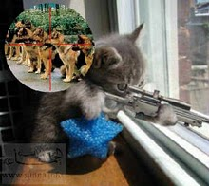
LP Relaxation
Block Co-ordinate Ascent on Dual
Focussed Inference

Slide 23
Focused Inference
Scheduling dual-updates in LPs
[Tarlow, Batra, Kohli, Kolmogorov, ICML ‘11]
Primal LP
Complementary Slackness
Objective
Dual LP
Computation

Slide 24
Focused Inference
Scheduling dual-updates in LPs
[Tarlow, Batra, Kohli, Kolmogorov, ICML ‘11]
Complementary Slackness
Objective
Current Primal-Dual Gap
Computation

Slide 25
Focused Inference
Scheduling dual-updates in LPs
[Tarlow, Batra, Kohli, Kolmogorov, ICML ‘11]
Local Primal-Dual Gaps
Generalization of Complimentary Slackness Conditions
Primal contribution minus Dual Contribution
Distributed Primal-Dual Gap
Upper-bound on improvement in dual

Slide 26
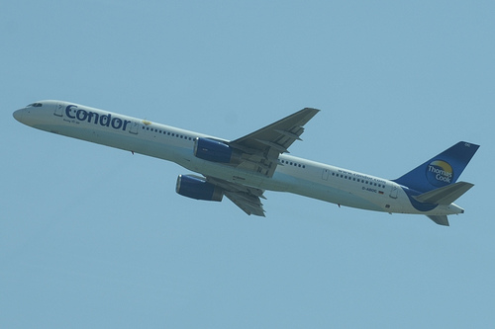
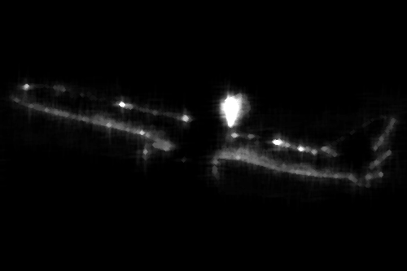
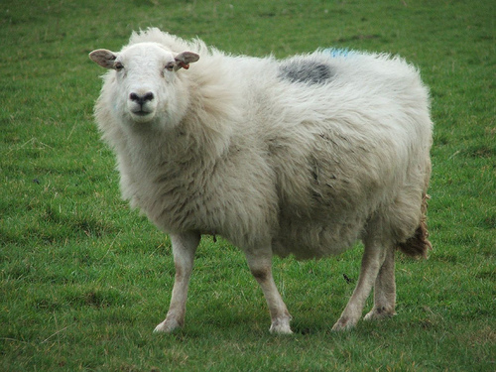
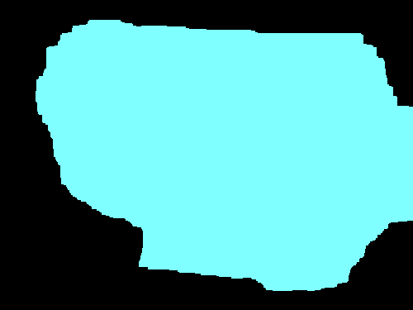
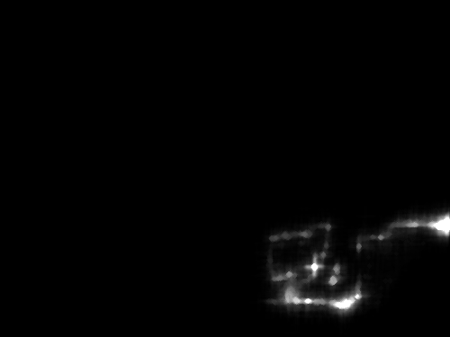
Focused Inference
Dynamic Segmentation
Image
Current Seg.
Update Mask
Updated Seg.
Messages

Slide 27
Focused Inference
Focused Inference
Energy-Aware Message-Passing ICML ‘11
Label Re-ordering in α-Expansion CVPR ‘11
Tightening LP Relaxations AISTATS ‘11
Ordering of Labels
Move Number | Classical Expansions | Our Guided Expansions
1 | Airplane | Sheep
2 | Bicycle | Dog
3 | Bird | Bird
4 | Boat | Cow
5 | Bottle | Cat

Slide 28
Dynamic Re-ordering of Blocks
Goal: Category Segmentation
α-Expansion solves the standard LP relaxation
Loop over α
Current Soln
2-Label Problem + GC
New Soln
α-Expansion
α

Slide 29
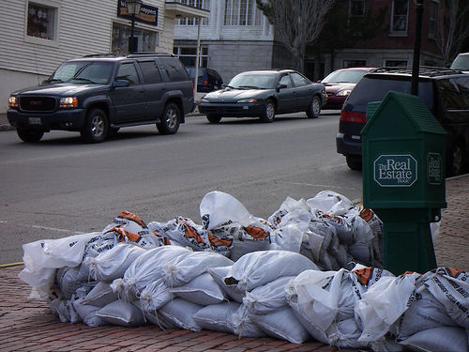
Dynamic Re-ordering of Blocks
Ordering of Labels
Move Number | Classical Expansions | Our Guided Expansions
Image 1
1 | Airplane | Car
2 | Bicycle | Person
3 | Bird | Motorbike
4 | Boat | Train
5 | Bottle | Airplane
Image 2
1 | Airplane | Sheep
2 | Bicycle | Dog
3 | Bird | Bird
4 | Boat | Cow
5 | Bottle | Cat

Slide 30
Dynamic Re-ordering of Blocks
LPDG score

Slide 31
Experiments

Slide 32
Focused Inference
Focused Inference
Energy-Aware Message-Passing ICML ‘11
Label Re-ordering in α-Expansion CVPR ‘11
Tightening LP Relaxations AISTATS ‘11
Ordering of Labels
Move Number | Classical Expansions | Our Guided Expansions
1 | Airplane | Sheep
2 | Bicycle | Dog
3 | Bird | Bird
4 | Boat | Cow
5 | Bottle | Cat

Slide 33
LP Relaxation
LP-relaxation
[Schlesinger ‘76, Koster ’98, Chekuri ‘01, Wainwright ’05]
Primal LP
Objective
Dual LP
Computation

Slide 34
LP Relaxation
LP-relaxation
[Schlesinger ‘76, Koster ’98, Chekuri ‘01, Wainwright ’05]
Primal LP
Objective
Dual LP
Computation

Slide 35
Hierarchy of LPs
Increasingly Complex Sub-problems
Edge-Consistent LP
Triplet-Clique Consistent LP
LPDG to the rescue!
-- Score Clusters / Constraints -- Add high scoring ones

Slide 36
Experiments

Slide 37
Structured Output Prediction
Focused Inference -- [Batra, Nowozin, Kohli AISTATS ’11] -- [Batra, Kohli CVPR ’11] -- [Tarlow, Batra, Kohli, Kolmogorov ICML ‘11]
Modeling
Inference
M-Best Modes -- [Yadollahpour, Batra, Shakhnarovich, DISCML-NIPS ’11]
Learning

Slide 38
Recall MAP
MAP

Slide 39
Problems with MAP
Large-scale studies
[Meltzer, Yanover, Weiss ICCV05]
“the global minimum of the energy function does not solve many of the problems in the BP or Graph Cuts solutions.”
[Szeliski et al. PAMI08]
“the ground truth has substantially higher energy [than MAP]”

Slide 40
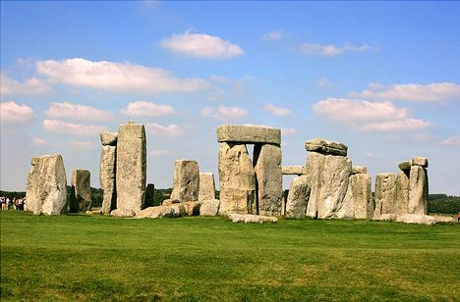
Problems with MAP
Reason: Model is misspecified
Potts Model

Slide 41
Solution
Ask for more than MAP!
M-Best MAP Problem
✓
Flerova et al., 2011
Rollon et al., 2011
Fromer et al., 2009
Yanover et al., 2003
Nilsson,1998
Seroussi et al., 1994
Lawler, 1972
Better Problem:
M-Best Modes

Slide 42
Integer Program
MAP

Slide 43
Key Idea
2nd-Best Mode

Slide 44
Special Cases
0-1 Dissimilarity M-Best MAP
[Nilsson; Yanover; Fromer; Flerova]
Max Dissimilarity Park & Ramanan ICCV11

Slide 45
Approach
2nd-Best Mode
Relax Boolean
Dualize

Slide 46
Dot-Product Dissimilarity
Inference:
For integral solution, equivalent to Hamming!
Simply edit node-terms. Reuse MAP machinery!

Slide 47
Example Results

Slide 48
Higher-Order Dissimilarity
Cardinality Potential
Efficient Inference
Cardinality [Tarlow ‘10]
Lower Linear envelop [Kohli ‘10]
Pattern Potentials [Rother ‘10]

Slide 49
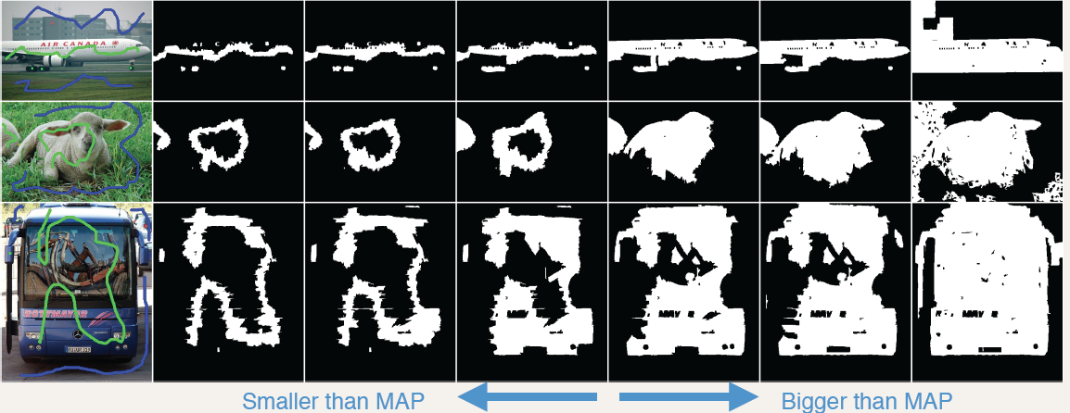
Example Results

Slide 50
Quantitative Results
MAP

Slide 51
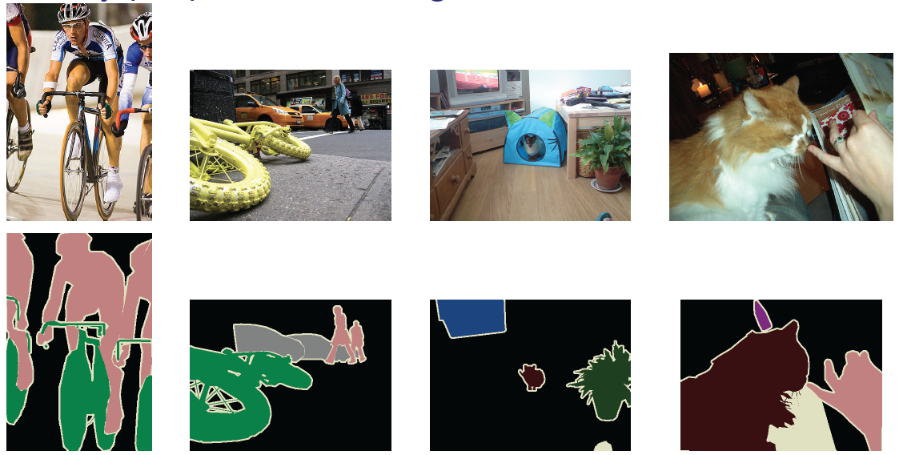
Experiment #2
Pascal Segmentation Challenge
20 categories + background

Slide 52
Experiment #2
ALE model
[Ladicky, Kohli, Torr]
Unary potential over pixels: textons, color, HOG
Pairwise potentials between pixels: Potts
Segment potentials: histogram of pixel features
Pairwise potentials between segments

Slide 53
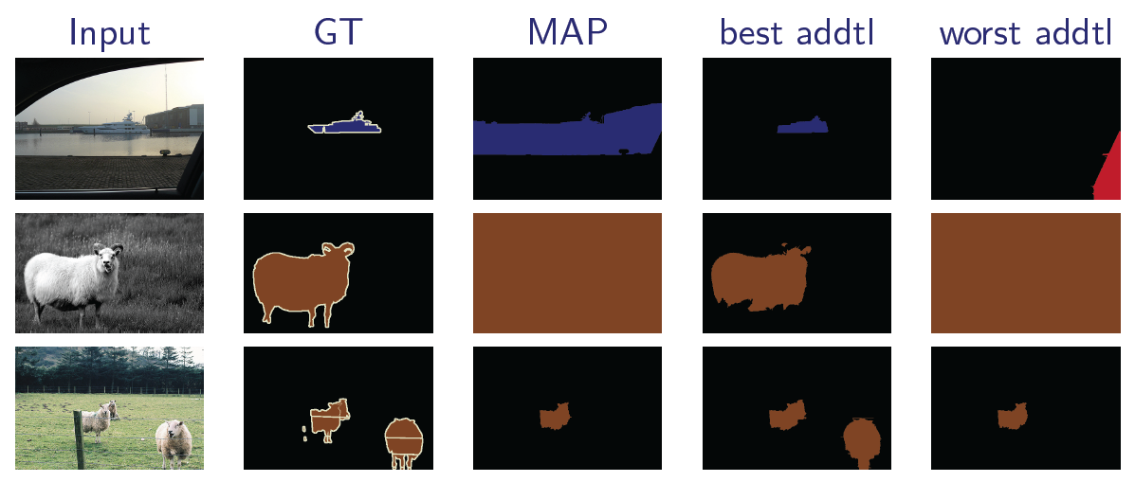
Examples: Large Improvement

Slide 54
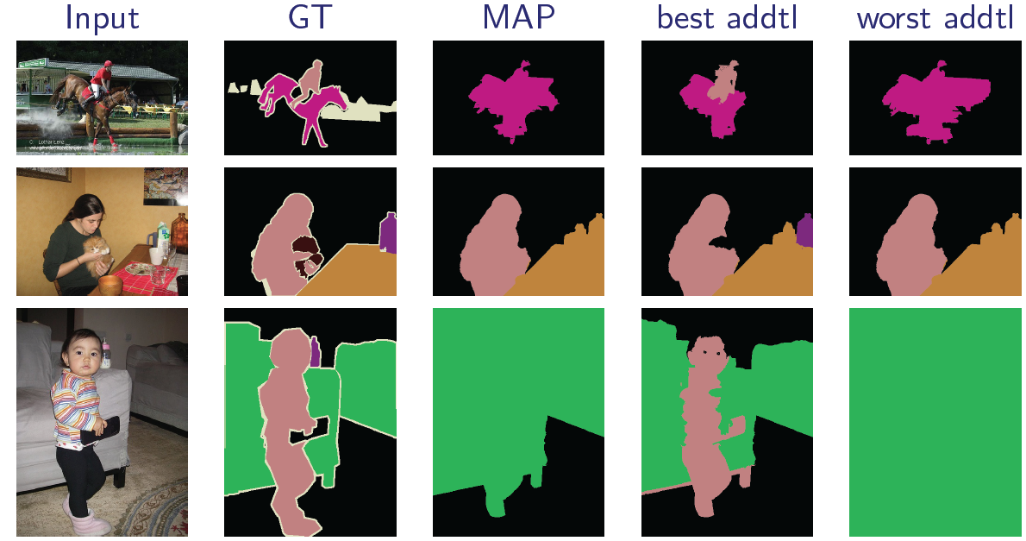
Examples: Medium Improvement

Slide 55
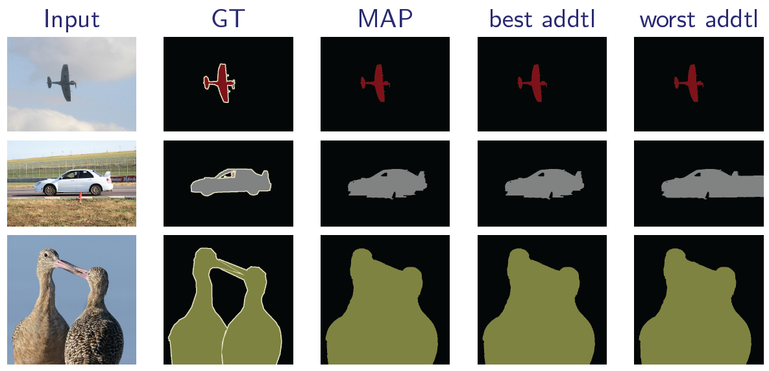
Examples: Small Improvement

Slide 56
Experiment #2
~10 years / im / soln

Slide 57
Structured Output Prediction
Focused Inference -- [Batra, Nowozin, Kohli AISTATS ’11] -- [Batra, Kohli CVPR ’11] -- [Tarlow, Batra, Kohli, Kolmogorov ICML ‘11]
Modeling
Inference
M-Best Modes -- [Yadollahpour, Batra, Shakhnarovich, DISCML-NIPS ’11]
Learning

Slide 58
Summary
Structured-outputs everywhere!
Focussed (faster) inference
M-Best modes extract better predictions

Slide 59
Thank You!

Slide 60
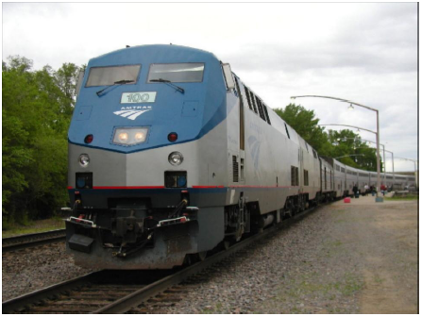
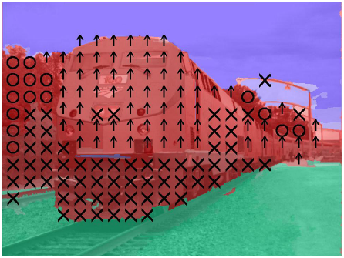
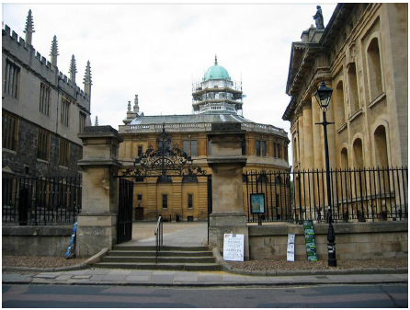
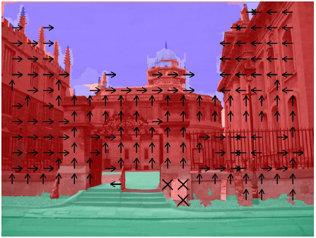
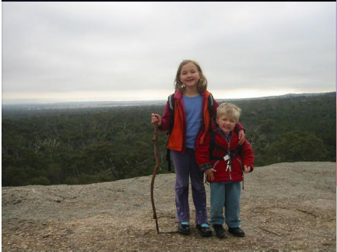
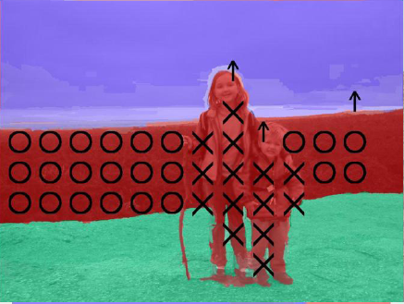
Structured Output
Geometric Labelling
[Hoiem et al. IJCV ’07], [Hoiem et al. CVPR ’08], [Saxena PAMI ’08], [Ramalingam et al. CVPR ‘08].

Slide 61
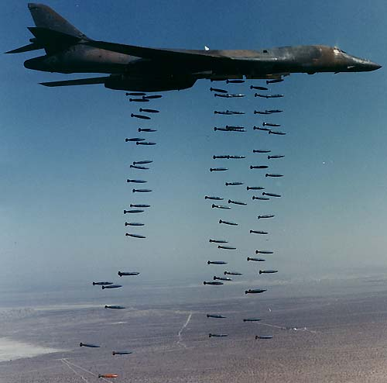
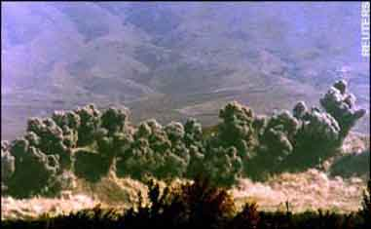
Approximate Inference
Carpet Bombing

Slide 62
Focused Inference

Slide 63
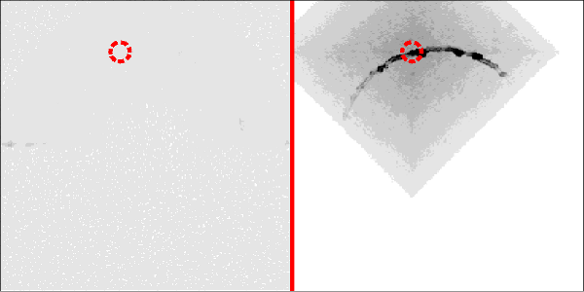
Focused Inference
Related Work: Query-Specific Inference
Choi & Darwiche ‘08
Chechetka & Guestrin ‘10

Slide 64
Focused Inference
Related Work: Query-Specific Inference
Choi & Darwiche ‘08
Chechetka & Guestrin ‘10
Our Work: Care about all variables
Static case
Dynamic case
time

Slide 65
MAP-MRF
Over-Complete Representation
kx1
k²x1

Slide 66
MAP-MRF
Energy
kx1
k²x1

Slide 67
MAP-MRF
Integer Program
Indicator Variables
Unique Label
Consistent Assignments

Slide 68
LP Relaxation
Linear Program
Tractable (but not scalable)

Slide 69
LP Relaxation
Linear Program --- Dual Program

Slide 70
LP Relaxation
Interpretation of Dual Program
Independently minimize terms
Subject to Reparameterization

Slide 71
LP Relaxation
Linear Program --- Dual Program
Complementary Slackness:

Slide 72
Local Primal-Dual Gap
Local Primal-Dual Gap
Defined for nodes & edges (higher order extensions later)
Contribution of each node and edge to the Primal-Dual Gap
Primal
Dual

Slide 73
Local Primal-Dual Gap
Intuition

Slide 74
Local Primal-Dual Gap
Properties
Decomposability
Quickly Computable
Sums to the total Primal-Dual Gap
Can easily define LPDG for sub-graphs
If no sub-graph with strictly positive LPDG exists, LP is tight

Slide 75
LP Relaxation
Two Problems
Non-tight LP?
Goal: better solution
How to chose blocks?
Goal: speed

Slide 76
Tightness of LP Relaxation
If
LP tight
Else
Primal-Dual Gap

Slide 77
Need for Tighter Relaxations
Evidence in literature
[Rother et al. CVPR07]
[Sontag et. al. UAI08]
On Protein dataset LP relaxation is tight for only 2/97 instances
[Batra et al. CVPR10]
LP perform very poorly

Slide 78
Tighter LP Relaxation
Linear Program --- Dual Program
Edge Consistency
Clique Consistency

Slide 79
Hierarchy of LPs
Increasingly Complex Sub-problems
Edge-Consistent LP
Triplet-Clique Consistent LP

Slide 80
Tighter LP Relaxation
Key Question: Which cliques?
triplet cliques
200 x 300 image ~= 3.6 x 10¹³ triplets
Can’t possibly add all

Slide 81
Goal
How do we incrementally tighten the standard LP relaxation for MAP inference in MRFs?
How do we find cliques to add?
Philosophy
“Optimally Lazy”

Slide 82
Sub-Goals
Two main issues
What is a good objective function (w)?
How do we solve this optimization?

Slide 83
Tightening Relaxations
A Few Previous Works:
[Werner CVPR08; Sontag NIPS07,UAI08; Komodakis ECCV08]
Basic Idea:
Maintain a “dictionary” of sub-structures (e.g. all 4-cycles)
Brute-force check each dictionary member
If adding this structure strictly improves relaxation, add it.

Slide 84
Sub-Goals
Two main issues
What is a good objective function (w)?
Can’t define w(G) to be “run inference and check”
How do we solve this optimization?
Can’t brute-force check exponentially many sub-structures
Max-Clique is NP-Hard

Slide 85
Sub-Goals
Optimizing the “true” objective function (increase in lower-bound) is hard.
Our Approach:
Use a surrogate objective function!

Slide 86
Local Primal-Dual Gap
Local Primal-Dual Gap
Generalizes Complementary Slackness
Contribution of each node and edge to the Primal-Dual Gap
Complementary Slackness
LPDG

Slide 87
Local Primal-Dual Gap
Intuition

Slide 88
Local Primal-Dual Gap
Properties
Decomposability
Quickly Computable
Well correlated with the true objective
Sums to the total Primal-Dual Gap
If no sub-graph with strictly positive LPD exists, LP is tight

Slide 89
Experiments
How good is LPDG as a cluster scoring function?
Random Energies, Stereo, De-convolution
Start with standard LP
Add triplets according to 5 scores
LPDG
Sontag et al UAI08
Random
Hybrid Methods:
LPDGcrisp+Sontag08
LPDG+Sontag
Constant time
Add and check

Slide 90
Experiments

Slide 91
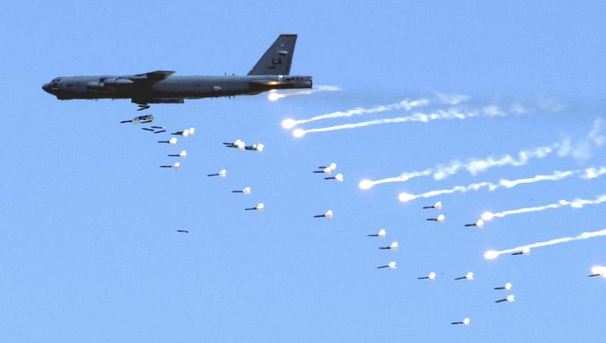
Carpet Bombing

Slide 92
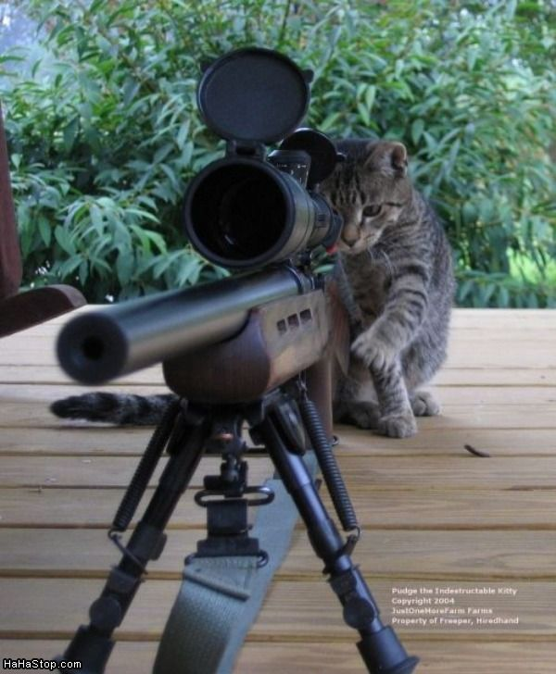
Focused Inference

Slide 93
Applications
What can we do with multiple solutions?
More choices for “human in the loop”

Slide 94
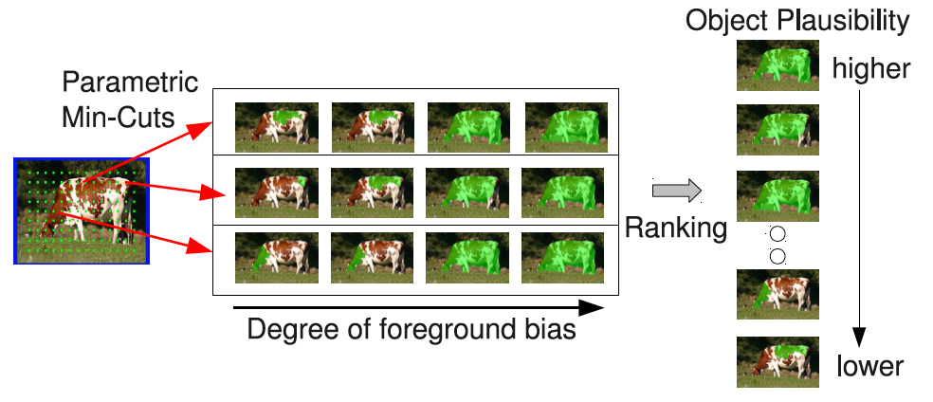
Applications
What can we do with multiple solutions?
More choices for “human in the loop”
Ranking solutions
Carreira and Sminchisescu, CVPR10

Slide 95
Applications
What can we do with multiple solutions?
More choices for “human in the loop”
Rank solutions
Better learning

Slide 96
Approach
2nd-Best Mode

Slide 97
Approach
2nd-Best Mode

