Slide 1
An Efficient Message-Passing Algorithm for the M-Best MAP Problem
Dhruv Batra
(Currently)
Research Assistant Professor
TTI-Chicago
(Spring 2013)
Assistant Professor
Virginia Tech

Slide 2

Local Ambiguity
Graphical Models
x₁
Hat
x₂
MAP
Inference
…
x_{n}
Cat
Most Likely Assignment
MAP Problem

Slide 3
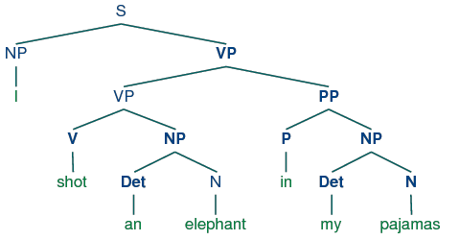
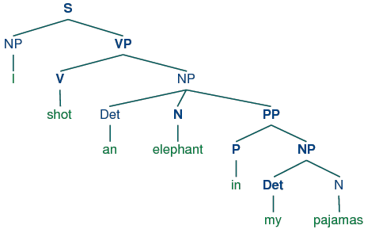
Global Ambiguity
“While hunting in Africa, I shot an elephant in my pajamas.
How an elephant got into my pajamas, I’ll never know!”
  Groucho Marx (1930)

Slide 4
M-Best MAP
Useful for:
  Generating multiple hypotheses when model is inaccurate
  Passing on hypotheses to next stage in cascade
  Show multiple solutions to users
Generalization of MAP, thus NP-Hard

Slide 5
History
 | MAP | M-Best MAP

Slide 6
History
 | MAP | M-Best MAP
Message-Passing Algs Dynamic Programming Belief Propagation style | [Pearl ’82], [Lauritzen & Spiegelhalter ‘88], [Shafer & Shenoy ‘86] | [Seroussi & Golmard ‘94], [Flerova & Dechter ‘10], [Yanover & Weiss ‘03], [Flerova & Dechter ’11]

Slide 7
History
 | MAP | M-Best MAP
Message-Passing Algs Dynamic Programming Belief Propagation style | [Pearl ’82], [Lauritzen & Spiegelhalter ‘88], [Shafer & Shenoy ‘86] | [Seroussi & Golmard ‘94], [Flerova & Dechter ‘10], [Yanover & Weiss ‘03], [Flerova & Dechter ’11]
Linear Programming Formulation | [Schlesinger ‘76], [Wainwright et al. ‘05], [Komodakis ’07] | [Fromer & Globerson ’09]

Slide 8
History
 | MAP | M-Best MAP
Message-Passing Algs Dynamic Programming Belief Propagation style | [Pearl ’82], [Lauritzen & Spiegelhalter ‘88], [Shafer & Shenoy ‘86] | [Seroussi & Golmard ‘94], [Flerova & Dechter ‘10], [Yanover & Weiss ‘03], [Flerova & Dechter ’11]
Linear Programming Formulation | [Schlesinger ‘76], [Wainwright et al. ‘05], [Komodakis ’07] | [Fromer & Globerson ’09]
Message-Passing for solving LP | [Schlesinger ‘76], [Wainwright et al. ‘05], [Kolmogorov ‘06], [Komodakis ’07], [Werner ’07]
This Work
[Batra UAI ’12]
?

Slide 9
Contributions
First message-passing alg for solving M-Best MAP LP of [Fromer & Globerson NIPS09]
Guaranteed to get exact solution to LP
Orders of magnitude faster than a generic LP solver
LP-solver
Time (sec)
Our Approach
Better
#Nodes

Slide 10
Outline
M
Tree-MRF M=2 | Tree-MRF M>2
Loopy MRF M=2 | Loopy MRF M>2
M=2 → M>2 Schemes
Partition Enumeration Scheme
[Fromer & Globerson NIPS09]
Others
Details in Paper
Cycles

Slide 11
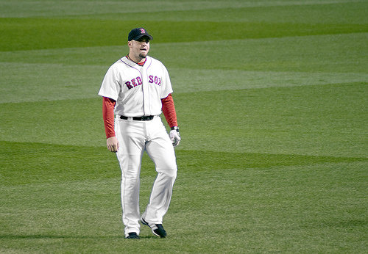

Background
x₁
Over-Complete Representation
…
…
…
x₂
…
kx1
…
…
X_{i}
x_{n}
kxk
…
…
…
1
0
0
0
0
1
0
0
1
1
0
0
0
0
0
0
kx1

Slide 12
Background
x₁
Over-Complete Representation
x₂
…
X_{i}
x_{n}
…
…
1
0
0
0
0
0
0
0
0
0
0
0
0
1
0
0
0
0
0
0
0
0
0
0
k²x1

Slide 13

Background
MAP Integer Program

Slide 14
Background
MAP Linear Program
Properties
  If LP-opt is integral, MAP is found
  LP always integral for trees
  Efficient message-passing schemes for solving LP

Slide 15
Outline
M
Tree-MRF M=2 | Tree-MRF M>2
Loopy MRF M=2 | Loopy MRF M>2
Cycles

Slide 16
M-Best MAP LP: Tree
Spanning-Tree Inequality
[Fromer & Globerson NIPS09]

Slide 17
M-Best MAP LP: Tree
Generic LP-solver: CPLEX
[Fromer & Globerson NIPS09]
~ 10⁶ x 10⁶

Slide 18
M-Best MAP LP: Tree
Lagrangian Relaxation
Similarity-Augmented Energy
Dualize
2-Pass
Belief Propagation

Slide 19

M-Best MAP LP: Tree
Lagrangian Relaxation
Dual Problem
upergradient Ascent
2nd Best MAP energy
Concave (Non-smooth)
Lower-Bound on 2nd Best MAP energy

Slide 20
M-Best MAP LP: Tree
Lagrangian Relaxation
Dual Problem
upergradient Ascent
primal point
Primal Block
Dual Block
dual point

Slide 21
M-Best MAP LP: Tree
Lagrangian Relaxation
Dual Problem
Guarantees
  Suitable choice of stepsize solves Lagrangian [Shor ‘85]
  LP => Strong Duality
upergradient Ascent

Slide 22
Outline
M
Tree-MRF M=2 | Tree-MRF M>2
Loopy MRF M=2 | Loopy MRF M>2
Cycles

Slide 23
M-Best MAP LP: Loopy-MRFs
,
,
…

Slide 24
M-Best MAP LP: Loopy-MRFs
Problems
1. Exponentially many Lagrangian Terms
2. Collection of factors not a tree
Dualize
,
,
…

Slide 25
Exponentially Many Terms
Dynamic
Constraint
Management
upergradient Ascent
primal point
Tree Subset
primal point
Primal Block
Dual Block
dual point
dual point
…

Slide 26
Exponentially Many Terms
Dynamic
Constraint
Management
upergradient Ascent
primal point
Tree Subset
Primal Block
Dual Block
dual point
Max-Weight Spanning Tree
Same as [Fromer & Globerson]
,
,
…

Slide 27
Loopy Graph
Problems
1. Exponentially many Lagrangian Terms
2. Collection of factors not a tree
Dual Decomposition
…

Slide 28
M-Best MAP LP: Loopy-MRFs
Guarantees
  Dynamic Supergradient Ascent w/ Max-Violation Oracle solves Lagrangian Relaxation [Emiel & Sagastizabal ‘08]
  LP => Strong Duality

Slide 29
Experiments
Synthetic Data
  Trees
  Grid Graphs
  Energies sampled from Gaussians
Methods
  STEELARS: Spanning TREE LAgrangian Relaxation Scheme [Proposed]
  STRIPES [Fromer & Globerson NIPS09]
  BMMF [Yanover & Weiss NIPS03]
  NILSSON [Nilsson Stat. & Comp. 98]

Slide 30
Results: Tree-MRFs
Better

Slide 31
Results: Loopy-MRFs
Better

Slide 32
Extension: Diverse M-Best
Task-Specific
Diversity
  Diverse M-Best Solutions in MRFs
  Batra, Yadollahpour, Guzman, Shakhnarovich
  ECCV 2012

Slide 33
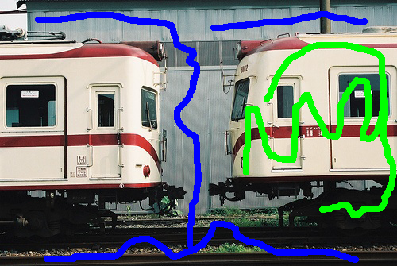


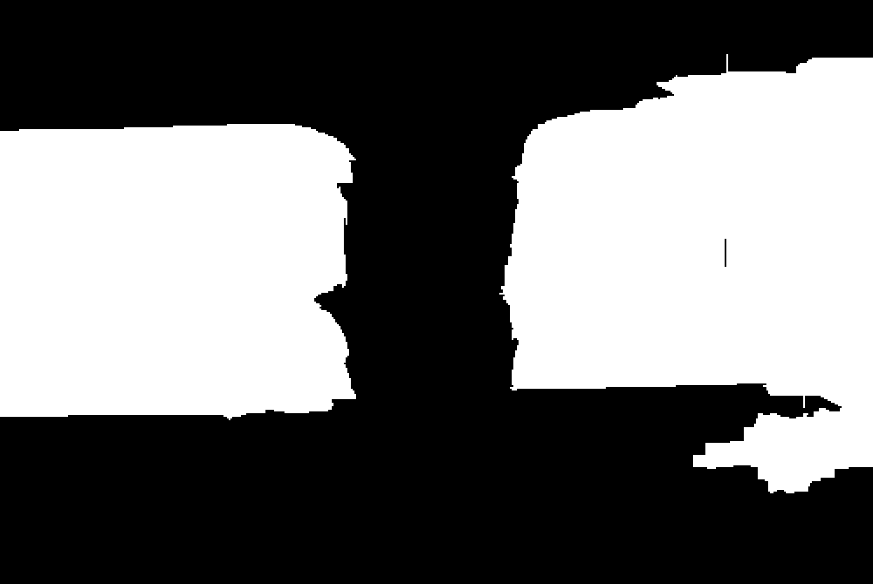
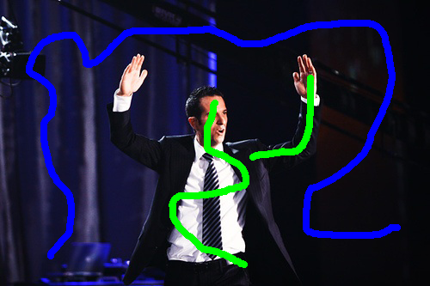



Extension: Diverse M-Best
Interactive Segmentation
Image + Scribbles
MAP
2nd Best MAP
2nd Best Mode
1-2 Nodes Flipped
100-500 Nodes Flipped

Slide 34




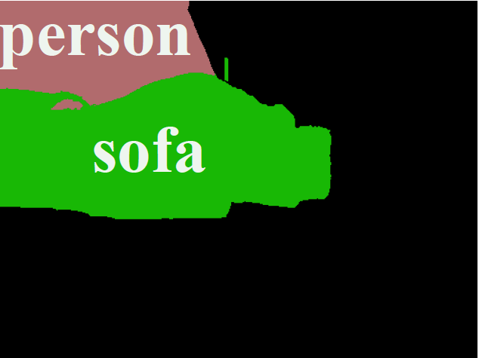


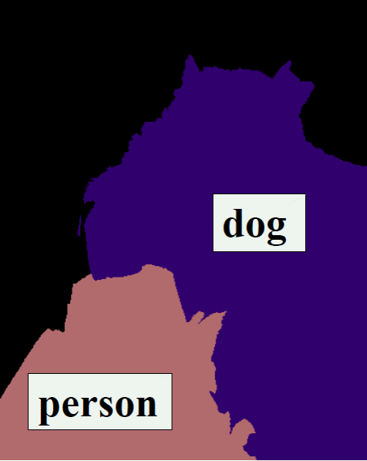
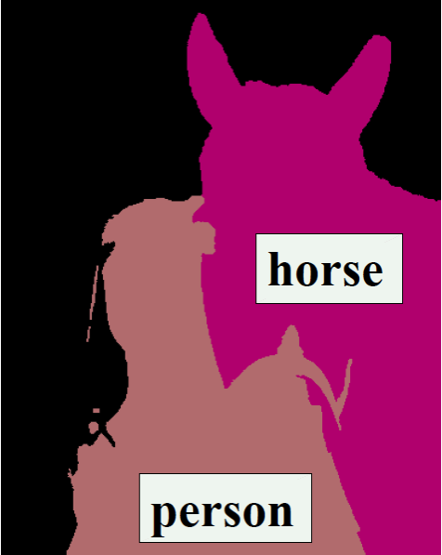
Extension: Diverse M-Best
Input
MAP
Best Mode

Slide 35
Conclusions
First message-passing alg for solving M-Best MAP LP
Guaranteed to get exact solution to LP
Orders of magnitude faster than a generic LP solver
Extension:
  Diverse M-Best Solutions in MRFs
  Batra, Yadollahpour, Guzman, Shakhnarovich
  ECCV 2012

Slide 36
Thank you!

Slide 37
Results: Tree-MRFs

Slide 38
Quality of Solutions: Loopy-MRFs

Slide 39
Results: Loopy-MRFs

Slide 40
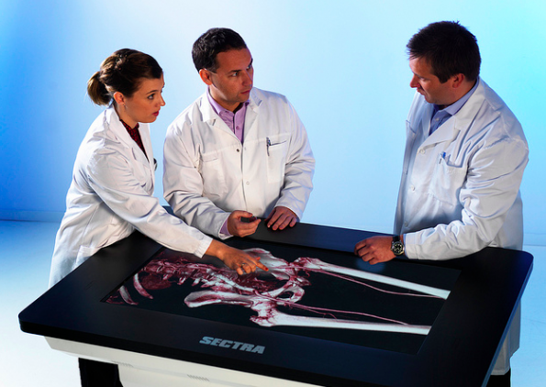
Applications
What can we do with multiple solutions?
  More choices for “human/expert in the loop”

Slide 41
Applications
What can we do with multiple solutions?
  More choices for “human/expert in the loop”
  Input to next system in cascade
Step 1
Top M
Step 2
Top M
Step 3
hypotheses
hypotheses

Slide 42
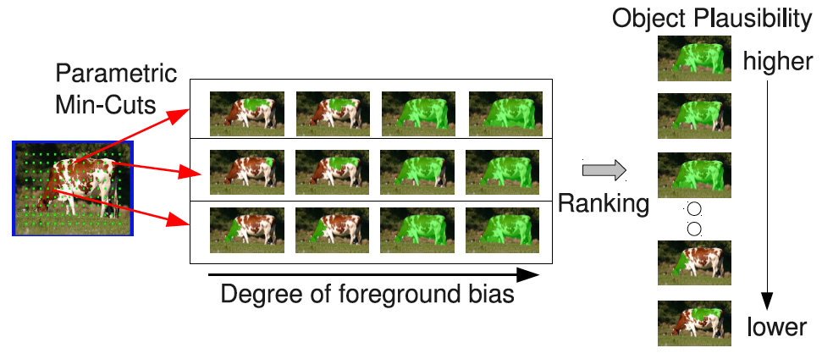
Applications
What can we do with multiple solutions?
  More choices for “human in the loop”
  Rank solutions
~10,000
[Carreira and Sminchisescu, CVPR10]
State-of-art segmentation on PASCAL Challenge 2011

